Slide 1

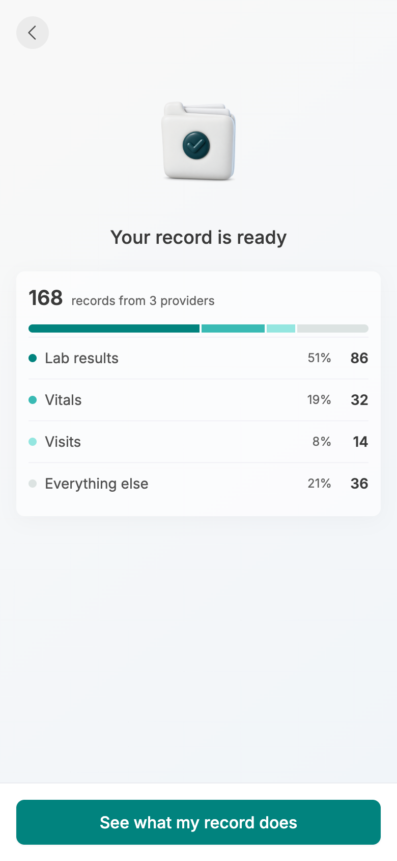
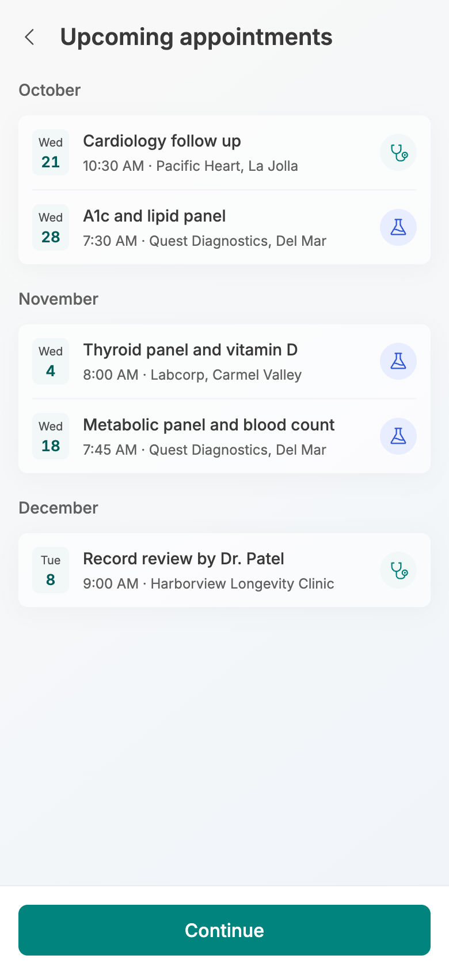
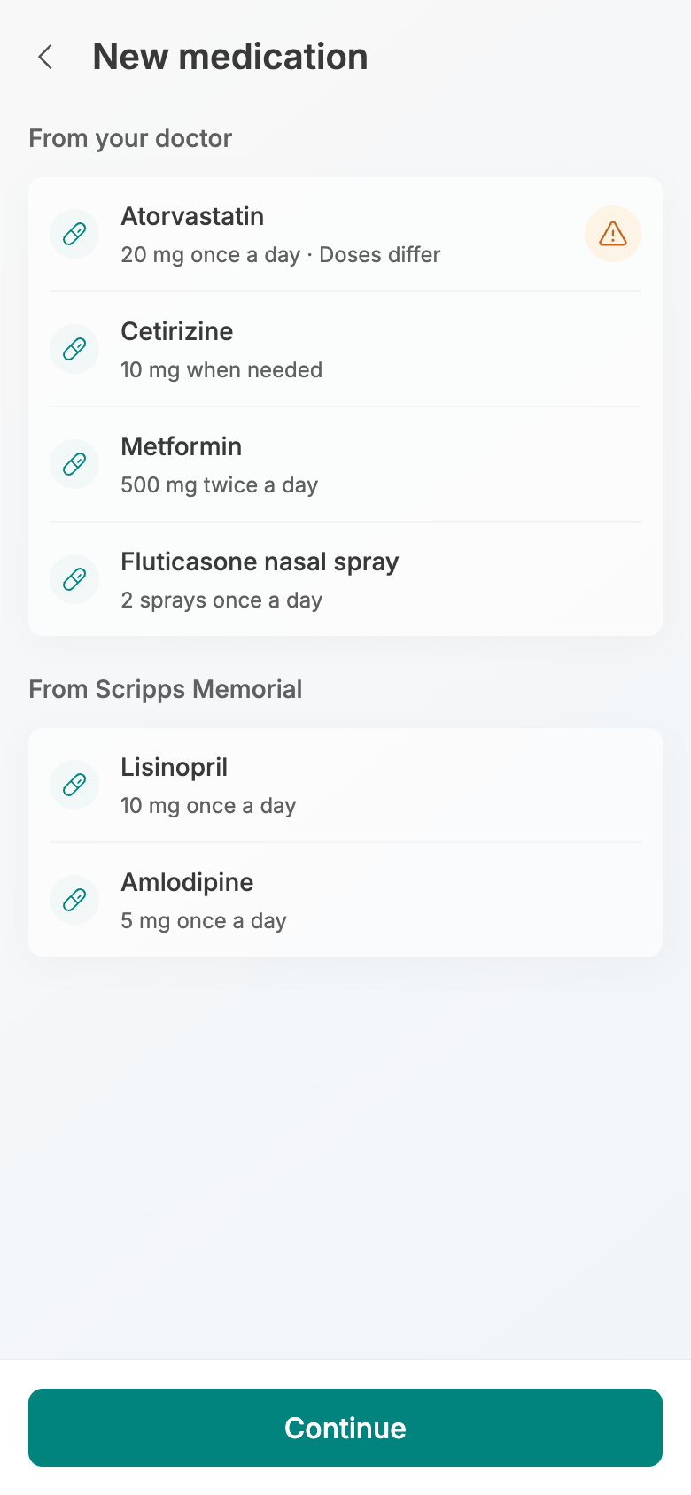
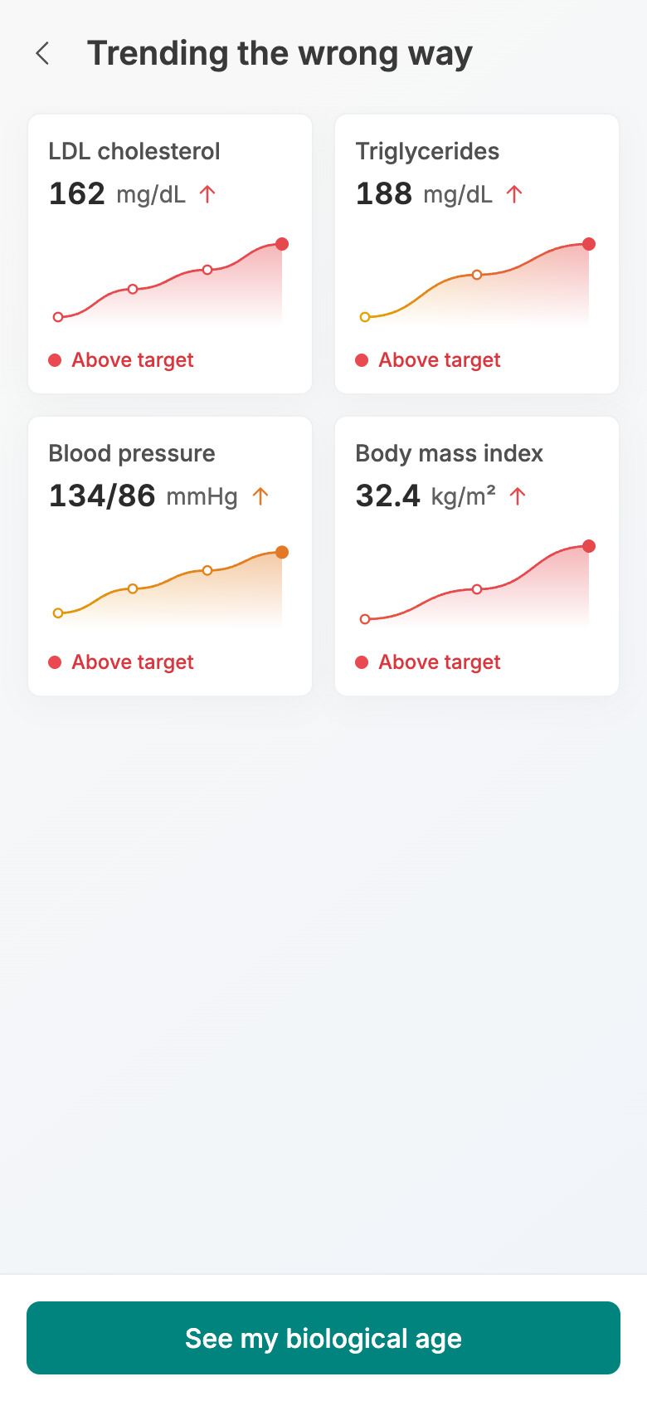
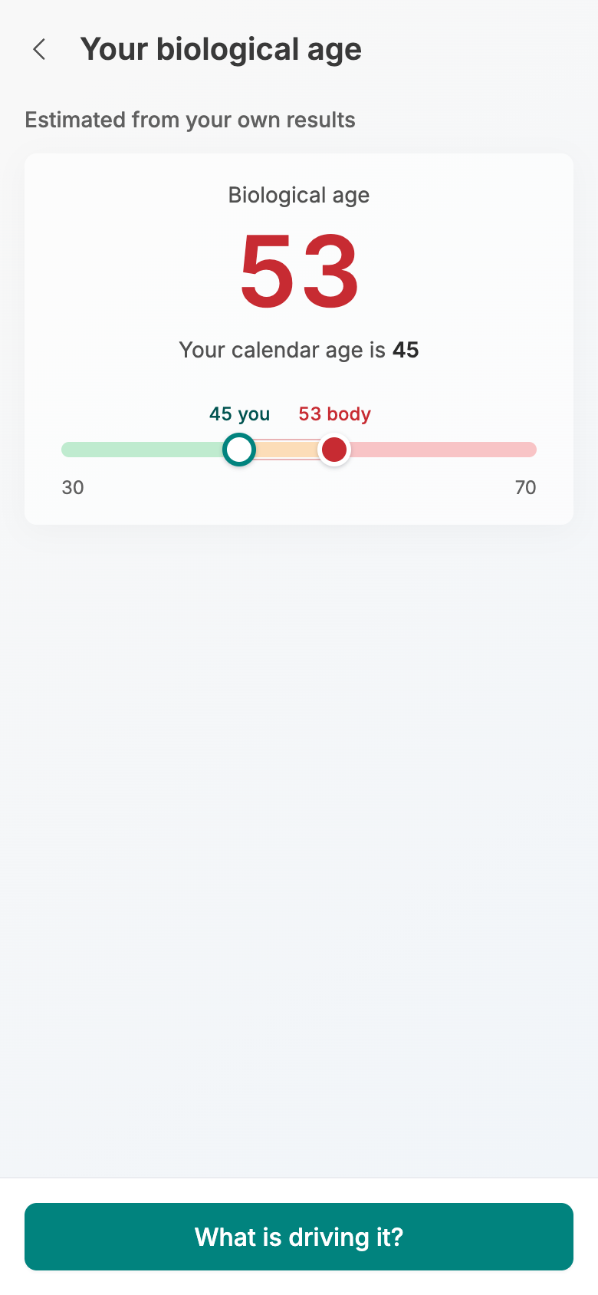
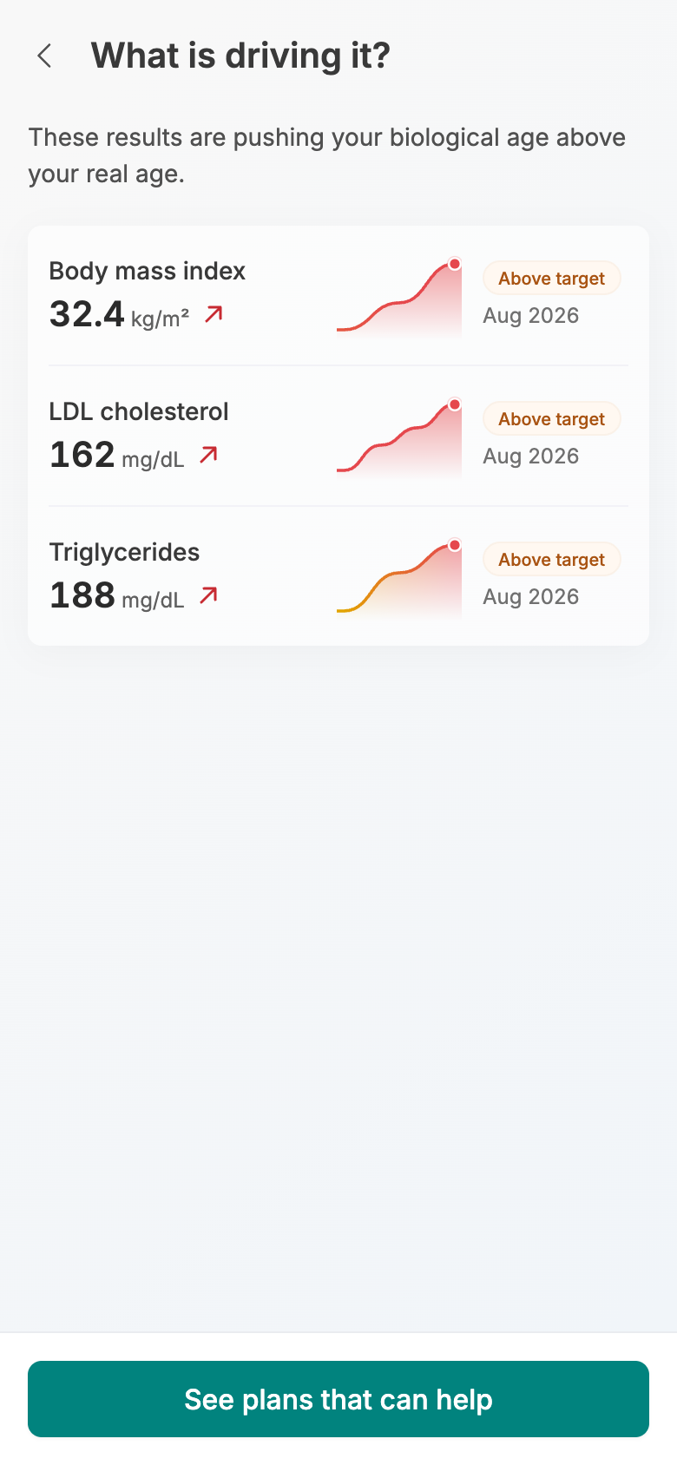
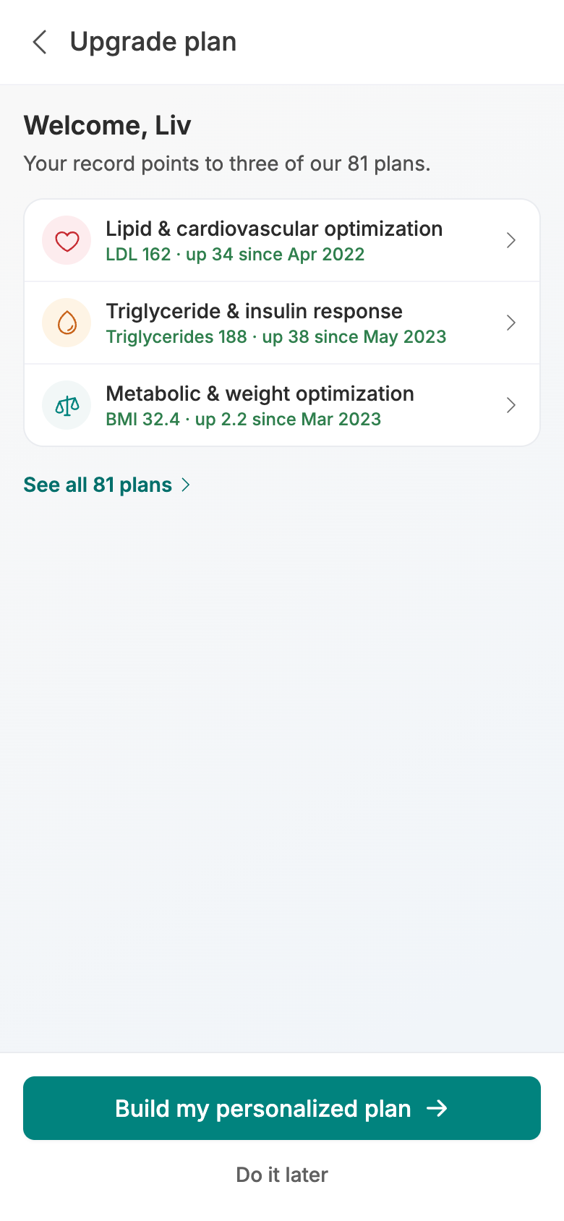
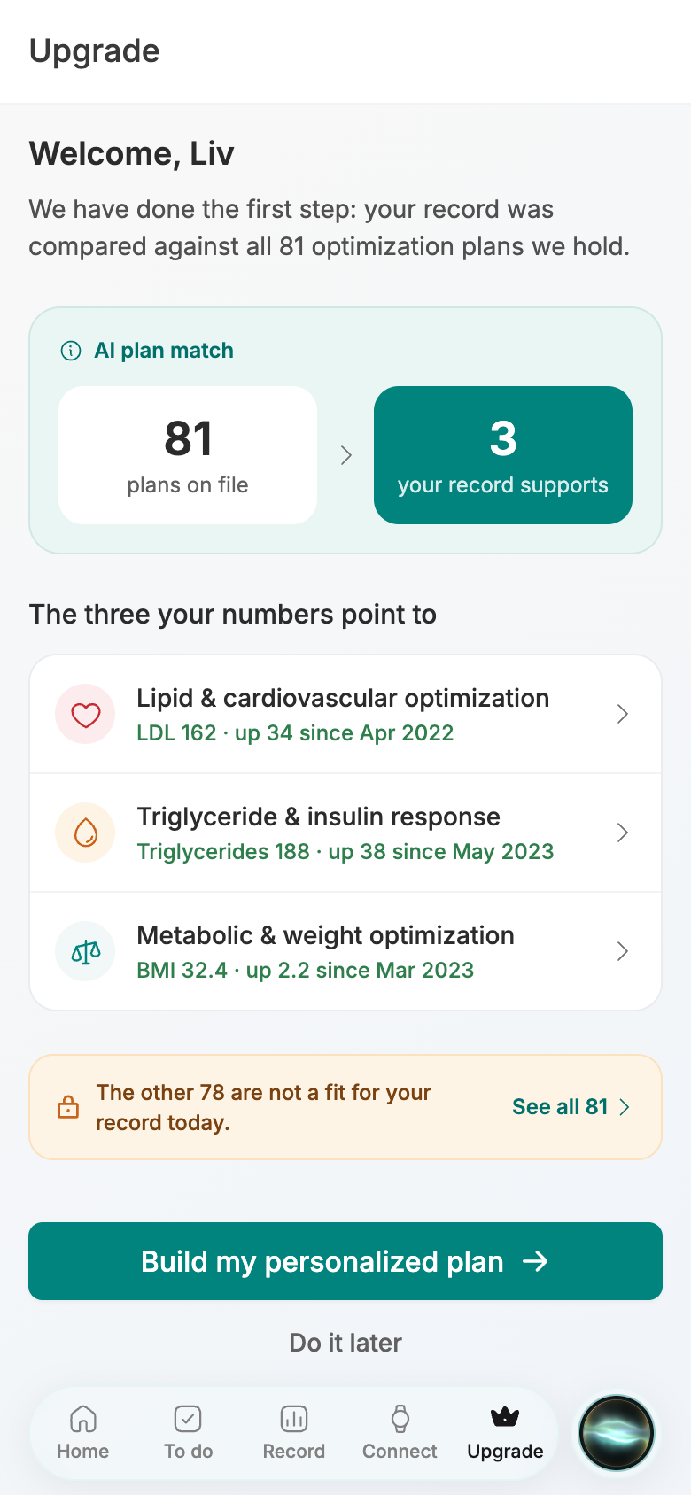
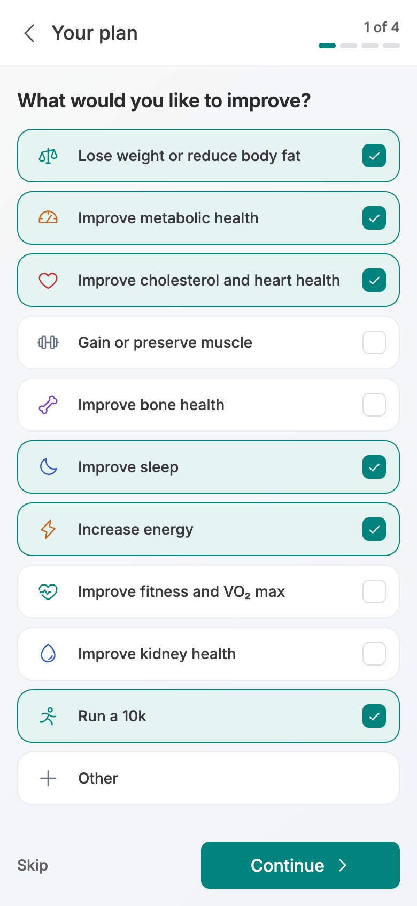
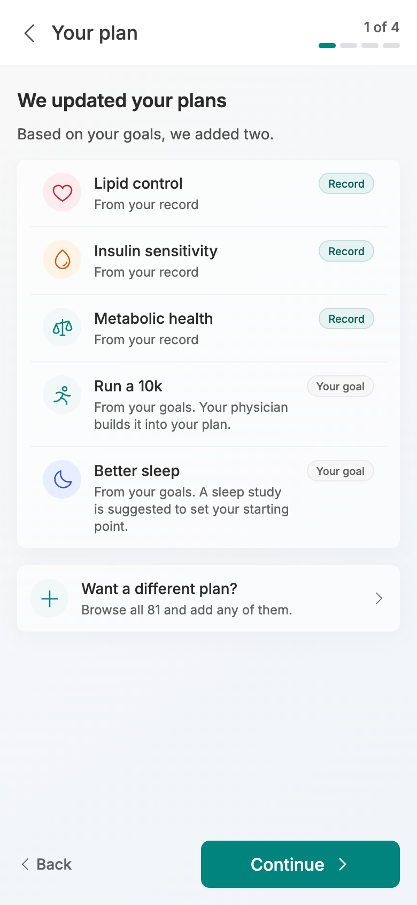
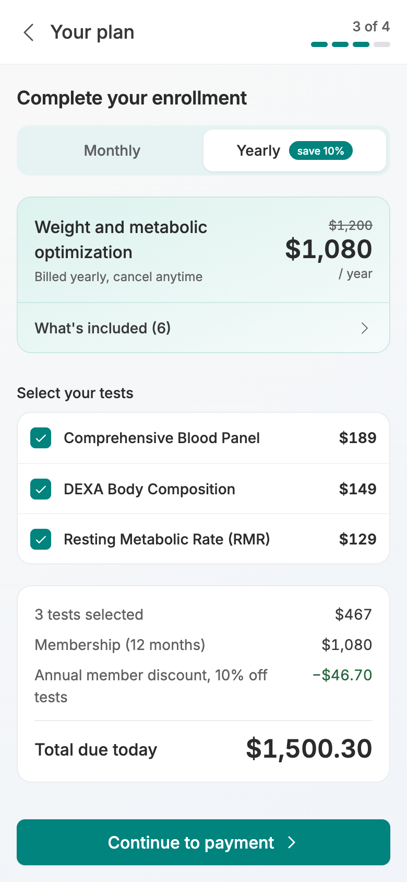
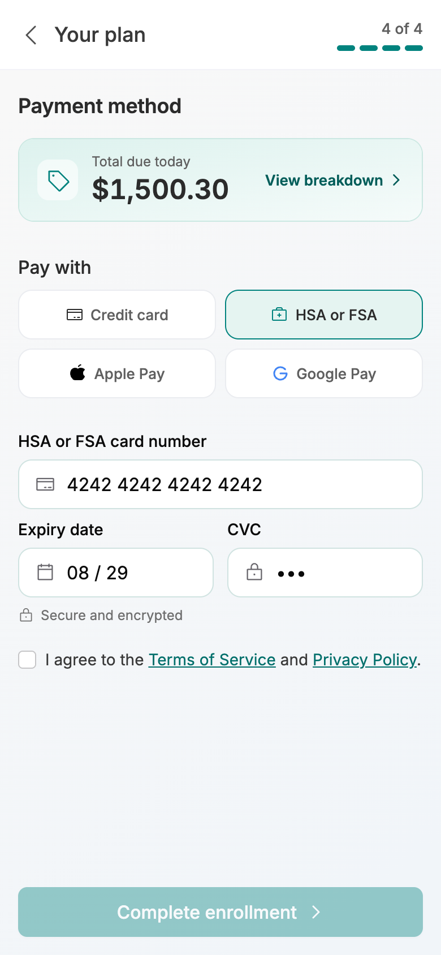
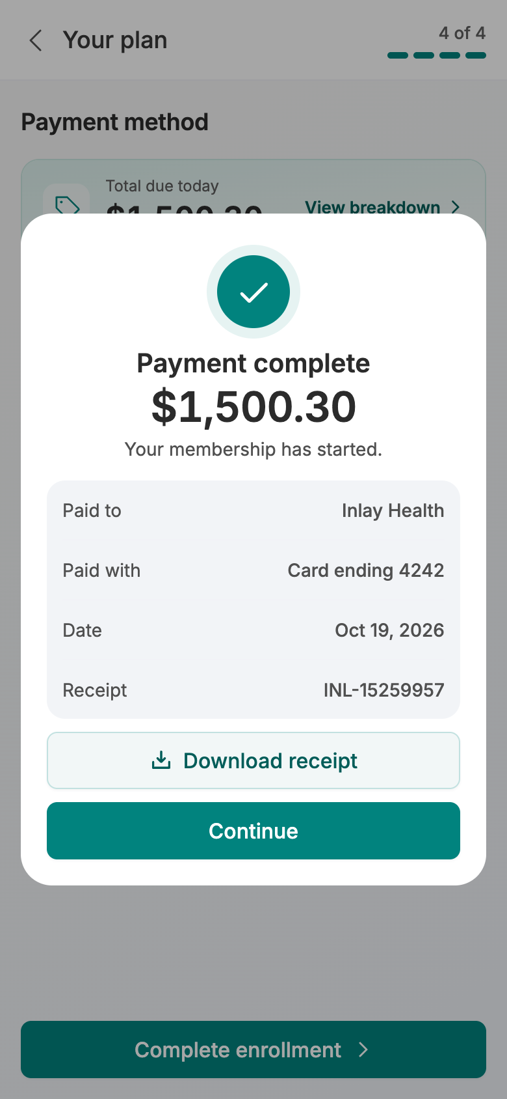
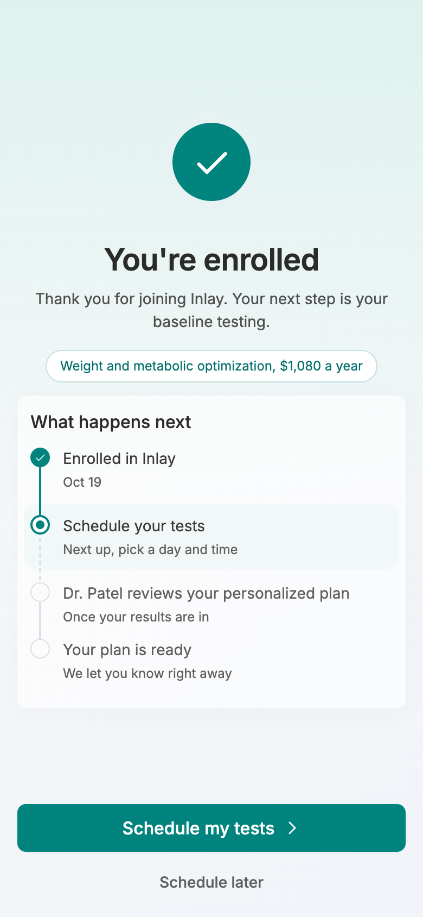
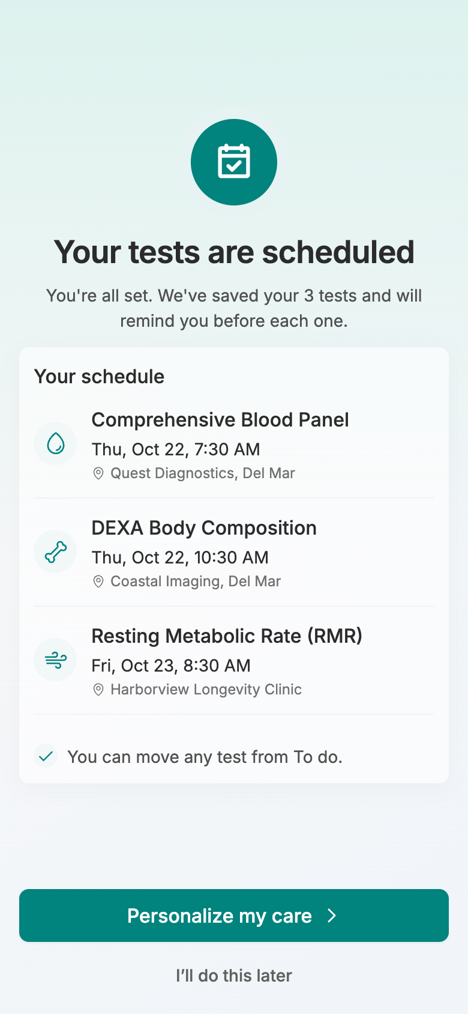
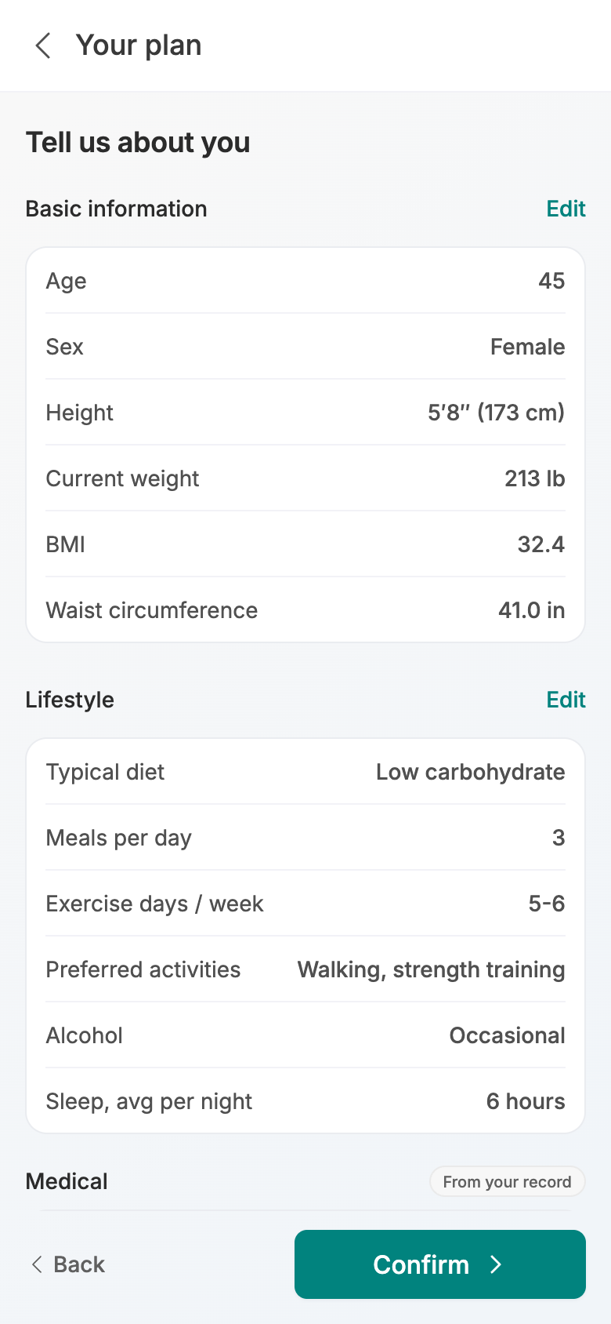
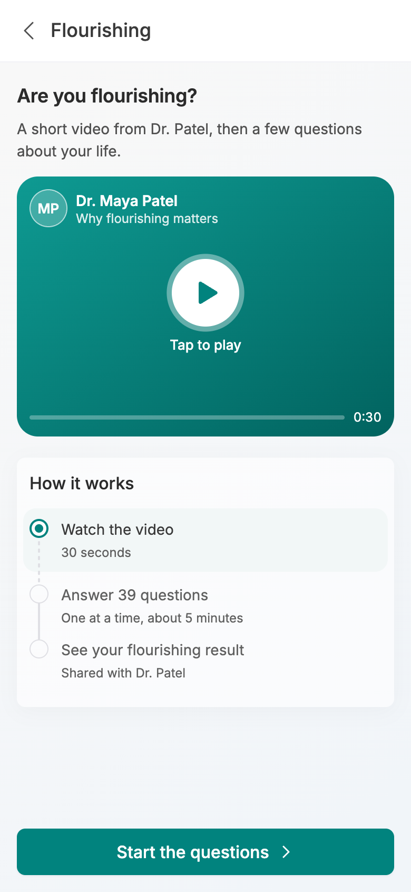
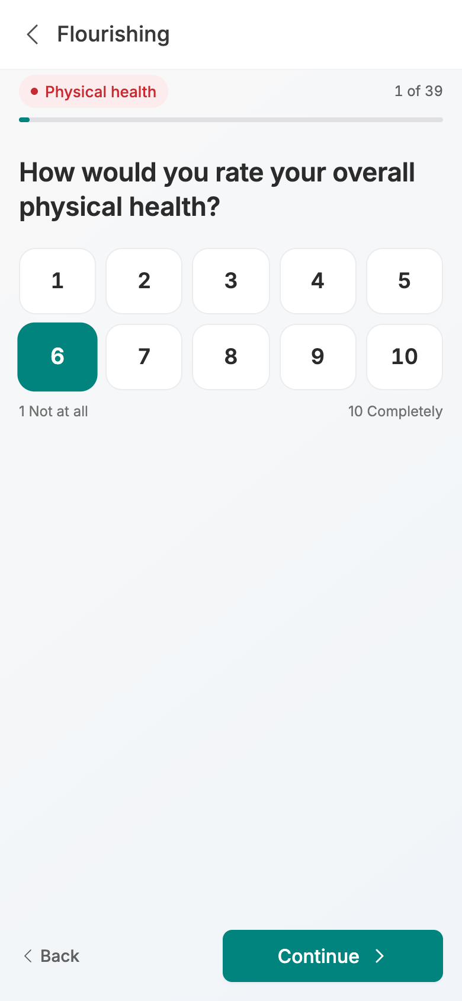
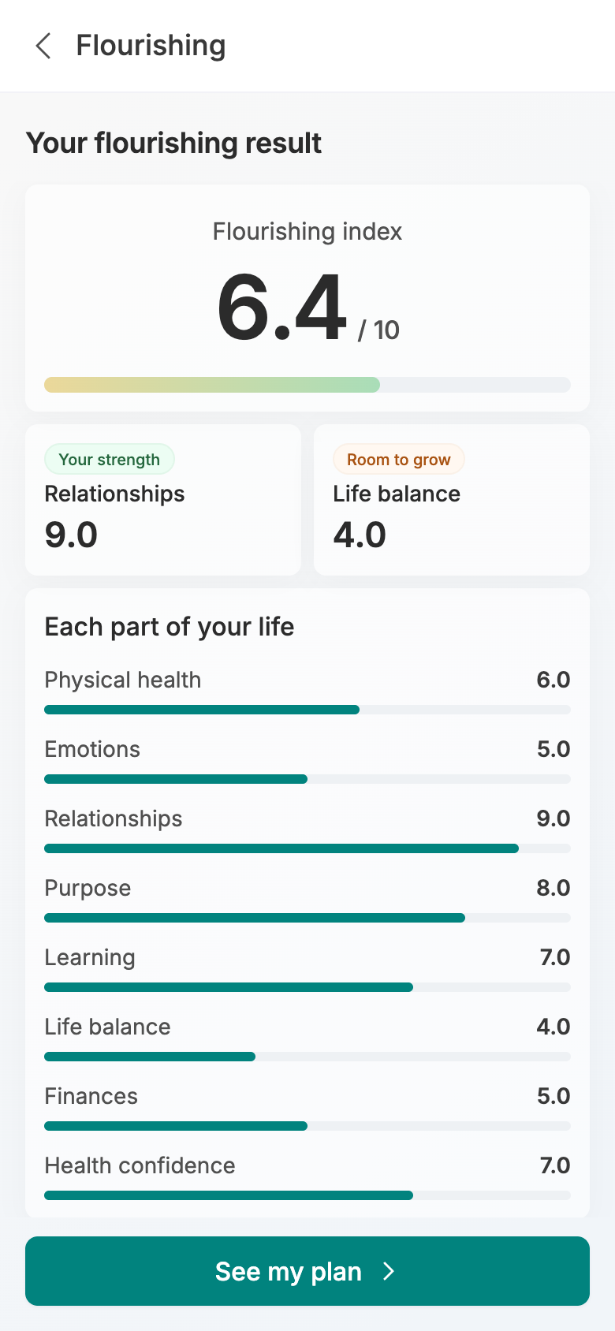
OPTIMIZATION PROGRAM · VERSION 15
What Changed After 16 Oct
Every screen that is new or changed in the patient app after the 16 Oct review with Dr. Blanchard.
03 Onboarding
05 Free Plan & Upgrade
19 screens · 10 new · 8 changed · 1 moved · 1 removed
Internal discussion draft · 19 October 2026
Screens captured from the current local build

Slide 2

What changed since version 14
The record now shows its value before the upgrade, goals feed the plan picks, HSA or FSA pays, and a flourishing intro, questions and result follow payment.
New
10
Changed
8
Moved
1
Removed
1
3.2 Upcoming Appointments
3.3 New Medication
3.4 Trending the Wrong Way
3.5 Your Biological Age
3.6 What Is Driving It?
5.3 We Updated Your Plans
5.6 Payment Complete
5.10 Are You Flourishing?
5.11 Flourishing Question
5.12 Your Flourishing Result
3.1 Your Record Is Ready
5.1 Upgrade
5.2 What Would You Like to Improve?
5.4 Complete Your Enrollment
5.5 Payment Method
5.7 You're Enrolled
5.8 Your Tests Are Scheduled
5.9 Tell Us About You
3.7 Welcome, Liv
v14 30 Your Plan Is Being Reviewed
INLAY HEALTH · OPTIMIZATION PATIENT JOURNEY · CHANGES AFTER 16 OCT
SUMMARY
2

Slide 3
STAGE 03
Onboarding
3.1
3.2
3.3
3.4
3.5
After the record is built, a five screen tour shows its value first (appointments, new medication), then the trends, biological age and what drives it, and ends on the 3 of 81 plan match.
3.6
3.7
Screens 3.1 to 3.7

Slide 4
3.1
STAGE 03 · ONBOARDING
Changed
Your Record Is Ready
168 records, then the tour
The finished record is summarised as before, but the button no longer jumps to the dashboard. It opens a short tour of what the record already does for the patient.
168 records from 3 providers: lab results, vitals, visits and everything else, each with its share
What changed
Ends in the record tour, not the dashboard: 16 Oct, show what the record does before anything else (v14 screen 12)
See what my record does replaces Go to my dashboard and opens Upcoming appointments
Saved as a step, so a patient who closes the app comes back to the tour, not a rebuild
INLAY HEALTH · OPTIMIZATION PATIENT JOURNEY · CHANGES AFTER 16 OCT
SCREEN 3.1 OF 19
4

Slide 5
3.2
STAGE 03 · ONBOARDING
New
Upcoming Appointments
Everything already booked
The first thing the record shows is what is already on the calendar: lab draws and visits together, by month, read from the patient's own record.
October: cardiology follow up Wed 21 with Pacific Heart, A1c and lipid panel Wed 28 at Quest Diagnostics
What changed
New: 16 Oct, record value comes first, starting with upcoming appointments
November: thyroid panel and vitamin D at Labcorp, then a metabolic panel and blood count at Quest
December 8: record review by Dr. Patel at Harborview Longevity Clinic; a mark says lab test or visit
INLAY HEALTH · OPTIMIZATION PATIENT JOURNEY · CHANGES AFTER 16 OCT
SCREEN 3.2 OF 19
5

Slide 6
3.3
STAGE 03 · ONBOARDING
New
New Medication
Every list, in one place
The medicines each provider's list brought into the record, grouped by where they came from. Where two lists disagree, an amber mark says so for the doctor to settle.
From your doctor: atorvastatin 20 mg, cetirizine, metformin 500 mg twice a day, fluticasone nasal spray
What changed
New: 16 Oct, record value first, new medication second
From Scripps Memorial: lisinopril 10 mg and amlodipine 5 mg, now visible to Dr. Patel
Atorvastatin is marked Doses differ: 20 mg on the doctor's list, 10 mg on the hospital's
INLAY HEALTH · OPTIMIZATION PATIENT JOURNEY · CHANGES AFTER 16 OCT
SCREEN 3.3 OF 19
6

Slide 7
3.4
STAGE 03 · ONBOARDING
New
Trending the Wrong Way
Four results moving away
After the value, the hard part: the results from the last 12 months that are moving away from the patient's range, each as a trend tile with its last readings.
LDL 162, up from 150, and triglycerides 188, up from 172, both from Quest
What changed
Moved into onboarding: 16 Oct order puts trends right after the record's value
Blood pressure 134/86, up from 131/84, and BMI 32.4, up from 31.1
Only what the record says, nothing about plans or prices; See my biological age moves on
INLAY HEALTH · OPTIMIZATION PATIENT JOURNEY · CHANGES AFTER 16 OCT
SCREEN 3.4 OF 19
7

Slide 8
3.5
STAGE 03 · ONBOARDING
New
Your Biological Age
53, against a calendar age of 45
One number on one age line: the biological age counts up from the calendar age, and the patient can drag along the line to compare any age with their own.
Estimated from your own results: 53, eight years above a calendar age of 45 from the clinic's birth date
What changed
New: 16 Oct, biological age follows the trends
A hollow dot for you, a solid one for your body, the gap between them shaded
The estimate is a labelled sample until the biological age model is approved; calendar age is real
INLAY HEALTH · OPTIMIZATION PATIENT JOURNEY · CHANGES AFTER 16 OCT
SCREEN 3.5 OF 19
8

Slide 9
3.6
STAGE 03 · ONBOARDING
New
What Is Driving It?
The results behind the number
These results are pushing your biological age above your real age. Each one is a result in the record that is out of range or moving the wrong way.
BMI 32.4 leads, taken from the record, measured at the August visit
What changed
New: 16 Oct, puts the numbers in longevity terms, with BMI from the record
Then LDL 162 and triglycerides 188, each with its status and trend, the same rows as the Record tab
No years per result until the model can weigh them; See plans that can help ends setup
INLAY HEALTH · OPTIMIZATION PATIENT JOURNEY · CHANGES AFTER 16 OCT
SCREEN 3.6 OF 19
9

Slide 10
3.7
STAGE 03 · ONBOARDING
Moved
Welcome, Liv
Three of 81 plans
The plan match now ends onboarding: setup finishes, Home opens, and the upgrade page slides over it, so back lands on Home.
Your record points to three of our 81 plans, one line instead of the AI plan match card
What changed
Moved: 16 Oct, the 3 of 81 match follows What is driving it, before the dashboard (v14 screen 20)
Lipid and cardiovascular (LDL 162, up 34), triglyceride and insulin (188, up 38), metabolic (BMI 32.4)
See all 81 plans, then Build my personalized plan, or Do it later
INLAY HEALTH · OPTIMIZATION PATIENT JOURNEY · CHANGES AFTER 16 OCT
SCREEN 3.7 OF 19
10

Slide 11
STAGE 05
Free Plan & Upgrade
5.1
5.2
5.3
5.4
5.5
5.6
Goals feed the plan picks and the patient can add any of the 81, HSA or FSA pays with an itemized receipt, there is no approval hold, and a short video opens the flourishing questions and result.
5.7
5.8
5.9
5.10
5.11
5.12
Screens 5.1 to 5.12

Slide 12
5.1
STAGE 05 · FREE PLAN & UPGRADE
Changed
Upgrade
The same welcome, any time
The Upgrade tab repeats the welcome the patient saw at the end of onboarding: the AI plan match, the three plans and one way forward.
AI plan match: 81 plans on file, 3 your record supports, each with the number behind it
What changed
Repeats the onboarding welcome per 16 Oct; physician note removed, Do it later added (v14 screen 20)
The other 78 are not a fit for your record today, with See all 81
The physician note is gone; Do it later now sits under Build my personalized plan
INLAY HEALTH · OPTIMIZATION PATIENT JOURNEY · CHANGES AFTER 16 OCT
SCREEN 5.1 OF 19
12

Slide 13
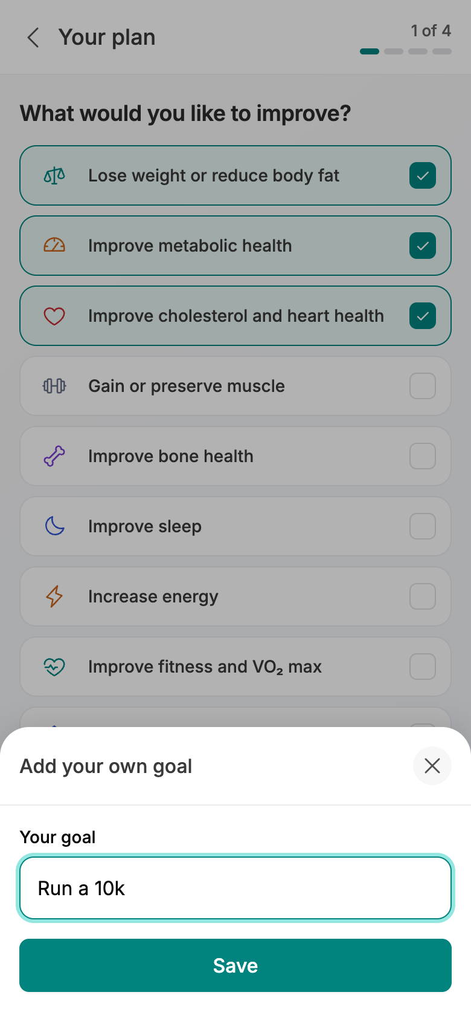
5.2
Goals picked
Add your own goal
STAGE 05 · FREE PLAN & UPGRADE
Changed
What Would You Like to Improve?
Their own goals, step 1 of 4
Goals are now their own step: nine goals in one list, several can be picked, and the ones the record backs start ticked.
Lose weight, metabolic health, cholesterol and heart, muscle, bone, sleep, energy, fitness and VO₂ max, kidney
Weight, metabolic health and cholesterol start ticked, because the record backs them
What changed
Goals are a separate step that feeds the plan picks: 16 Oct decision (v14 screen 22)
INLAY HEALTH · OPTIMIZATION PATIENT JOURNEY · CHANGES AFTER 16 OCT
SCREEN 5.2 OF 19
13

Slide 14
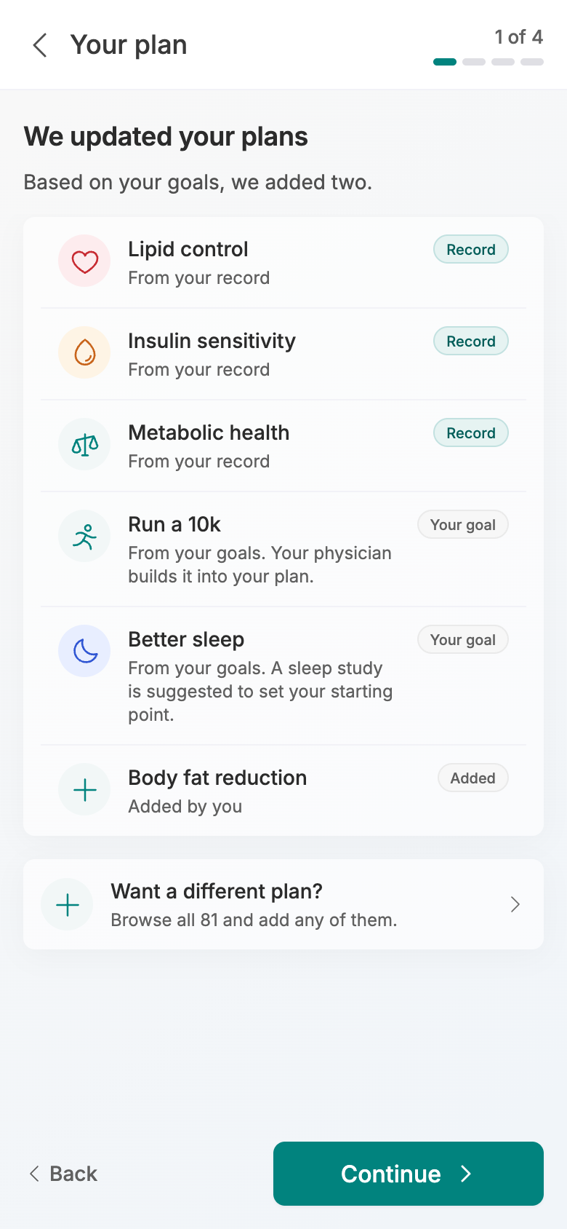
5.3
Goals add two plans
A plan the patient added
STAGE 05 · FREE PLAN & UPGRADE
New
We Updated Your Plans
Your goals add a plan
The plans the record points to, then what the goals added on top, up to five in all. Each row says where it came from.
Lipid control, insulin sensitivity and metabolic health come first, each tagged Record
Based on your goals, we added two: Run a 10k, and Better sleep with a sleep study to set its starting point
What changed
New: 16 Oct, goals feed the AI plan picks and the patient can add plans
INLAY HEALTH · OPTIMIZATION PATIENT JOURNEY · CHANGES AFTER 16 OCT
SCREEN 5.3 OF 19
14

Slide 15
5.4
STAGE 05 · FREE PLAN & UPGRADE
Changed
Complete Your Enrollment
Monthly or yearly, step 3 of 4
The plan named from the goals, monthly or yearly billing, and the baseline tests, all priced before payment.
Yearly $1,080, or $100 a month; yearly members get 10% off their tests
What changed
Simpler: the monthly versus yearly note removed; tests priced before payment per 16 Oct (v14 screen 26)
3 tests $467, annual member discount $46.70 off, total due today $1,500.30
The note comparing the two ways to pay is gone; the toggle says Save 10% on its own
INLAY HEALTH · OPTIMIZATION PATIENT JOURNEY · CHANGES AFTER 16 OCT
SCREEN 5.4 OF 19
15

Slide 16
5.5
STAGE 05 · FREE PLAN & UPGRADE
Changed
Payment Method
HSA or FSA, like any card
Step 4 of 4. An HSA or FSA card is now a way to pay of its own, beside credit card, Apple Pay and Google Pay.
Four ways to pay, two to a row: Credit card, HSA or FSA, Apple Pay, Google Pay
What changed
Adds HSA or FSA as a way to pay: 16 Oct decision (v14 screen 27)
HSA or FSA takes the same fields as a card, under HSA or FSA card number, secure and encrypted
Total due today $1,500.30; Complete enrollment stays off until the terms are ticked
INLAY HEALTH · OPTIMIZATION PATIENT JOURNEY · CHANGES AFTER 16 OCT
SCREEN 5.5 OF 19
16

Slide 17
5.6
STAGE 05 · FREE PLAN & UPGRADE
New
Payment Complete
Paid, with a receipt
Once the payment goes through, a popup confirms it before the enrolled page: the amount, the card and an itemized receipt to keep.
$1,500.30 paid to Inlay Health with the HSA or FSA card ending 4242, today's date and the receipt number
What changed
New: 16 Oct, an itemized receipt for HSA and FSA claims
Download receipt itemizes the membership, each test and the yearly discount, as HSA and FSA administrators ask
Continue opens You're enrolled
INLAY HEALTH · OPTIMIZATION PATIENT JOURNEY · CHANGES AFTER 16 OCT
SCREEN 5.6 OF 19
17

Slide 18
5.7
STAGE 05 · FREE PLAN & UPGRADE
Changed
You're Enrolled
What happens next, in order
The membership has started, and the payment is already confirmed. The screen lists each next step with the physician named.
Enrolled in Inlay today, then Schedule your tests
What changed
Drops the no charge until approval line: 16 Oct, no physician approval hold (v14 screen 28)
The line No charge until Dr. Patel approves your plan is gone: the patient has paid
Schedule my tests, or Schedule later, which keeps the tests in To do
INLAY HEALTH · OPTIMIZATION PATIENT JOURNEY · CHANGES AFTER 16 OCT
SCREEN 5.7 OF 19
18

Slide 19
5.8
STAGE 05 · FREE PLAN & UPGRADE
Changed
Your Tests Are Scheduled
Booked, then flourishing
Confirm schedule lands here: every test with its day, time and place, and a reminder before each one.
Blood panel at Quest Diagnostics, DEXA at Coastal Imaging, RMR at Harborview Longevity Clinic
What changed
Leads to the new flourishing questions; approval line removed, 16 Oct (v14 screen 29a)
You can move any test from To do; the no charge until approval line is gone
Personalize my care now leads through Tell us about you to the flourishing video and questions
INLAY HEALTH · OPTIMIZATION PATIENT JOURNEY · CHANGES AFTER 16 OCT
SCREEN 5.8 OF 19
19

Slide 20
5.9
STAGE 05 · FREE PLAN & UPGRADE
Changed
Tell Us About You
From the record, then confirmed
The profile as the record has it, in three blocks. The patient confirms it, and Confirm now opens Are you flourishing?
Basic information: age 45, weight 213 lb, BMI 32.4, waist 41 in
What changed
Confirm opens the new flourishing intro, per 16 Oct (v14 screen 29b)
Lifestyle edits in a sheet; medical is read from the record, never retyped
Confirm opens the flourishing video instead of the assistant's chat
INLAY HEALTH · OPTIMIZATION PATIENT JOURNEY · CHANGES AFTER 16 OCT
SCREEN 5.9 OF 19
20

Slide 21
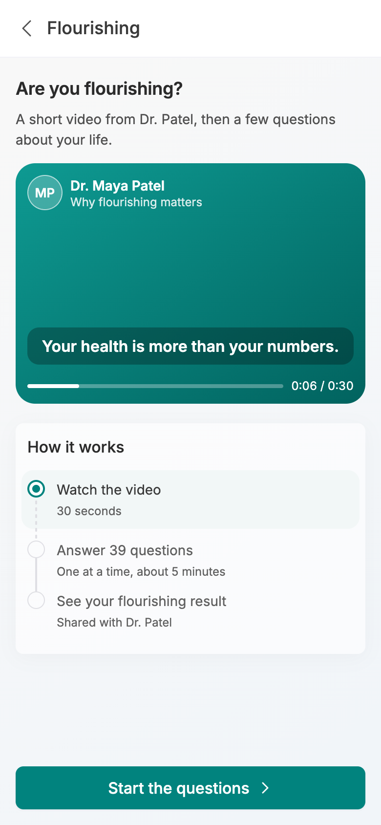
5.10
Before the video
Video playing
STAGE 05 · FREE PLAN & UPGRADE
New
Are You Flourishing?
A short video from Dr. Patel
Why first, then what: a 30 second video from Dr. Patel on why flourishing matters, then how the questions work.
Your health is more than your numbers: the captions play over the video, with play, pause and replay
How it works: watch the video, answer 39 questions, one at a time, about 5 minutes, see your result
What changed
New: 16 Oct, a flourishing intro with a video under 60 seconds (v14 screen 29c)
INLAY HEALTH · OPTIMIZATION PATIENT JOURNEY · CHANGES AFTER 16 OCT
SCREEN 5.10 OF 19
21

Slide 22
5.11
STAGE 05 · FREE PLAN & UPGRADE
New
Flourishing Question
One question, ten buttons
The flourishing questions as a questionnaire, not a chat: one question a page, the part of life as a coloured chip, 1 of 39 and a thin bar.
A 1 to 10 scale as ten big buttons, 1 Not at all to 10 Completely; Continue moves on
What changed
Replaces the chat: 16 Oct, mandatory flourishing questions; free text and voice answers still to come (v14 screen 29c)
Eight parts of life in order, from physical health to health confidence, 39 questions in all
Every answer saved as it is made; the one optional question has Prefer not to answer
INLAY HEALTH · OPTIMIZATION PATIENT JOURNEY · CHANGES AFTER 16 OCT
SCREEN 5.11 OF 19
22

Slide 23
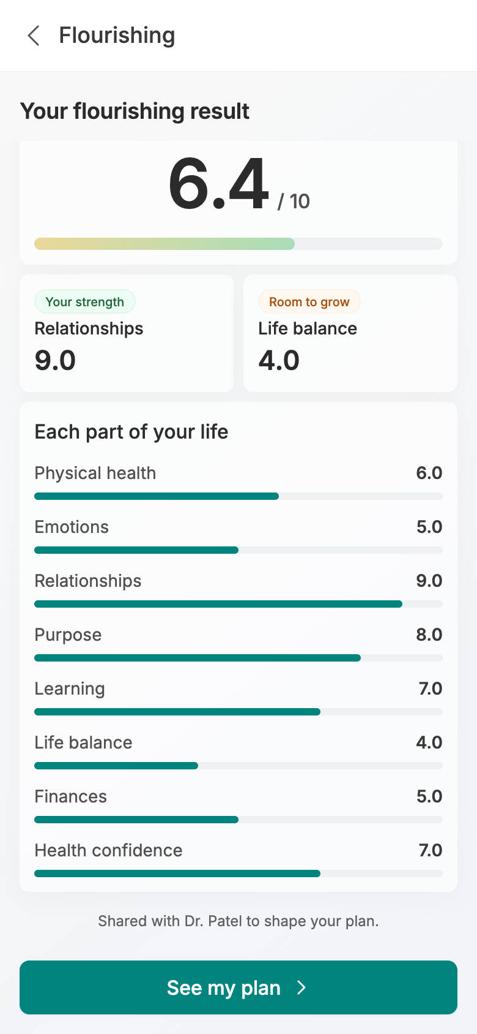
5.12
Overall and extremes
Each part of life
STAGE 05 · FREE PLAN & UPGRADE
New
Your Flourishing Result
A score per part of life
The flourishing index out of 10 with one bar, then the strongest and weakest parts of life, then each of the eight parts as its own bar.
Your strength and Room to grow name the highest and lowest parts of life, with their scores
Each part of your life: physical health, emotions, relationships, purpose and four more
What changed
New: 16 Oct, a flourishing result per domain
INLAY HEALTH · OPTIMIZATION PATIENT JOURNEY · CHANGES AFTER 16 OCT
SCREEN 5.12 OF 19
23

Slide 24
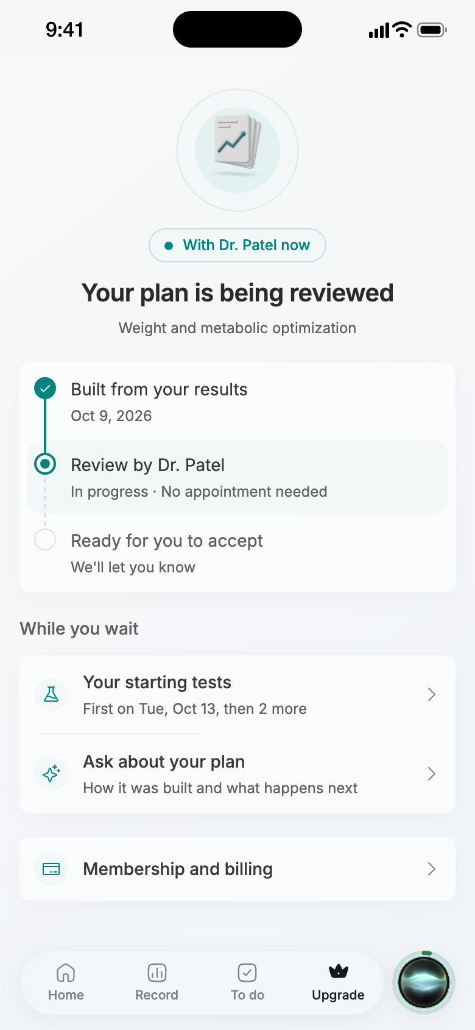
Taken out of the journey
Per the 16 Oct call there is no physician approval hold: the patient accepts the plan and the doctor is informed.
Removed
Your Plan Is Being Reviewed
Was v14 screen 30
Removed: 16 Oct, no physician approval hold; the patient accepts and the doctor is informed
INLAY HEALTH · OPTIMIZATION PATIENT JOURNEY · CHANGES AFTER 16 OCT
REMOVED
24

Slide 25
STILL OPEN
Decisions these screens wait on
HSA eligibility
Flourishing questions and licence
HOL to confirm with an ERISA attorney before the HSA or FSA option and receipt ship.
Question set per domain under Dr. Blanchard's review; Harvard licence and benchmark data with HOL.
Rejecting every plan
Biological age model
What happens when a patient declines all plans: a refund was suggested, nothing decided.
The age shown is a labelled sample until the model and its inputs are approved.
Goal-setting questions
Free versus paid
Dr. Blanchard is writing about 10 SMART goal questions to replace the goal list.
Which features stay free (trends, appointments, medicines) still to be tested and decided.

